Slide 1



Slide 2




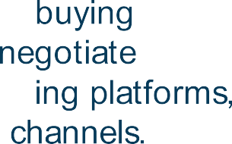











Slide 3





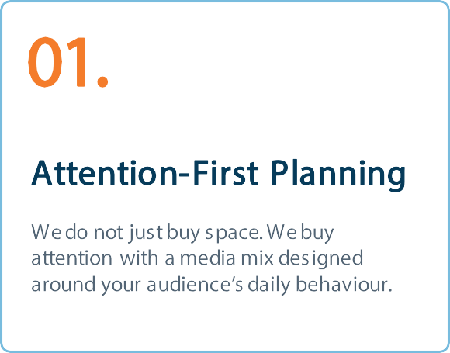
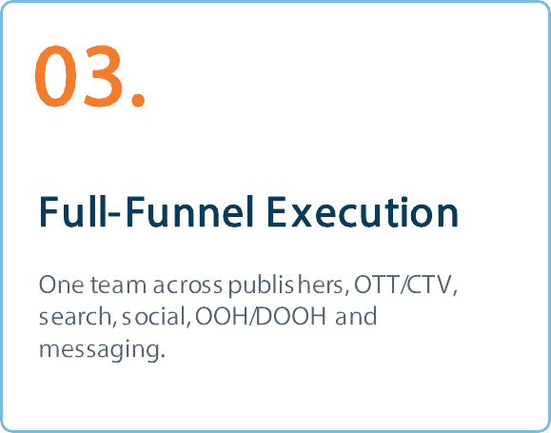
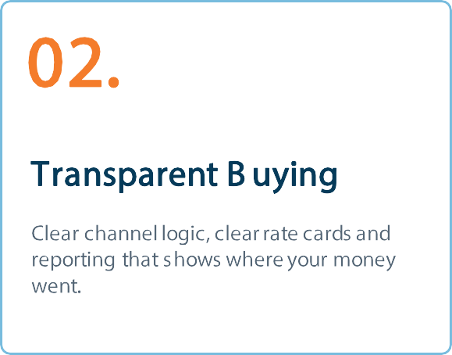

Slide 4



















Slide 5













Slide 6



















Slide 7
SERVICE SECTION
01.
Premium Media Network
Publisher-first plans that place your brand in relevant, trusted
environments.
PREMIUM MEDIA NETWORK
07

Slide 8




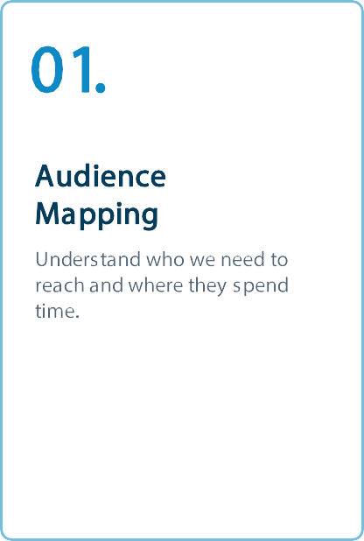
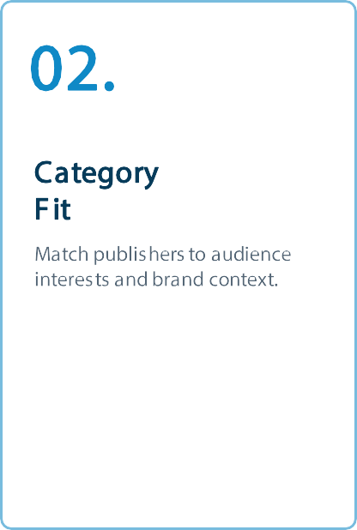

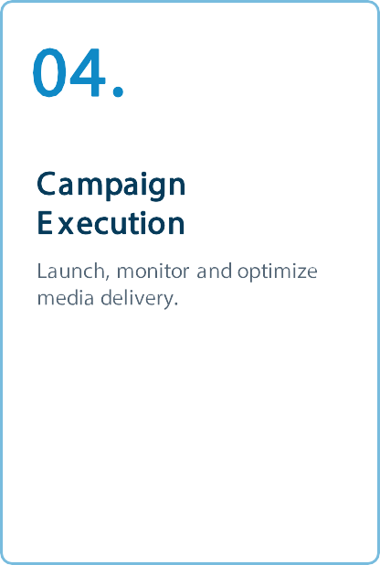
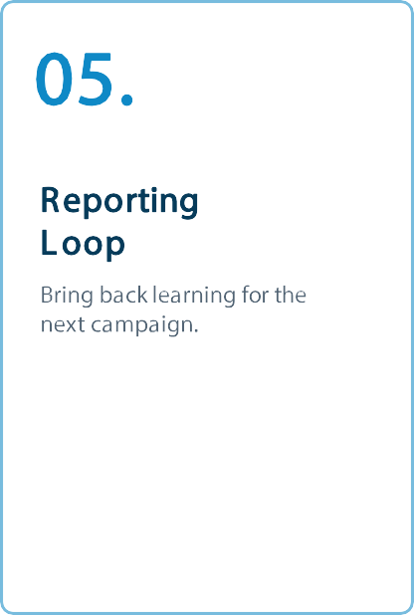

Slide 9









Slide 10


























Slide 11









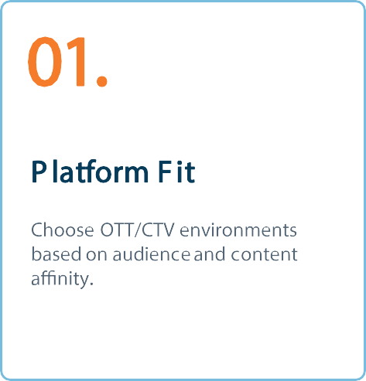
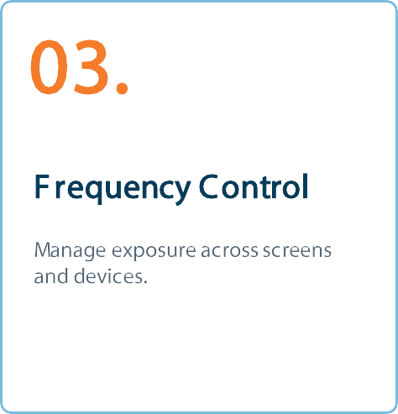
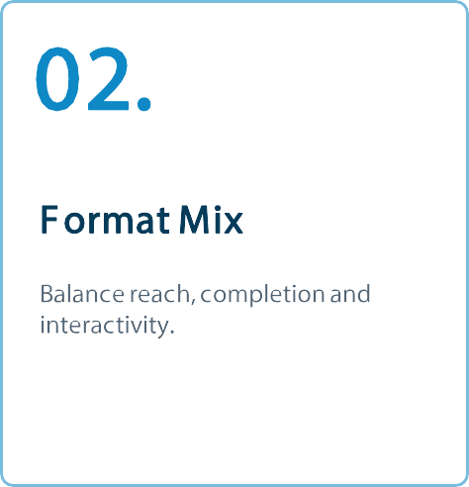
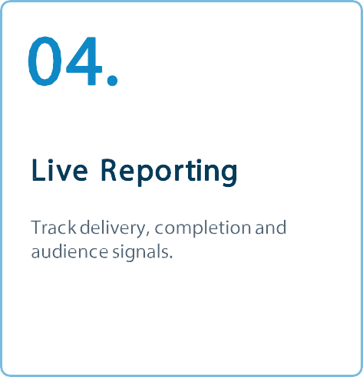

Slide 12










Slide 13










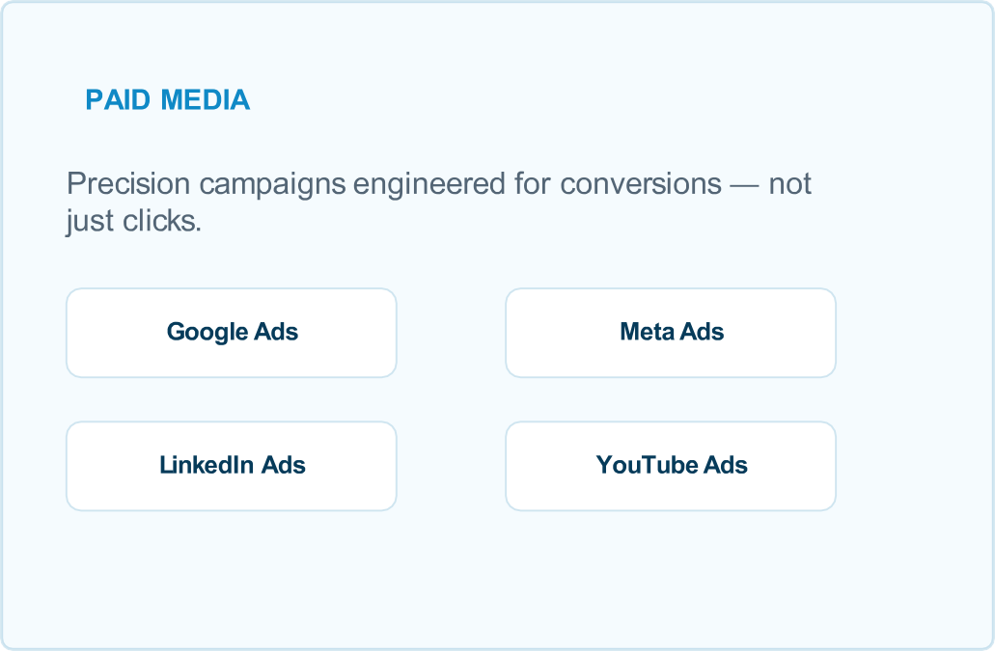


Slide 14




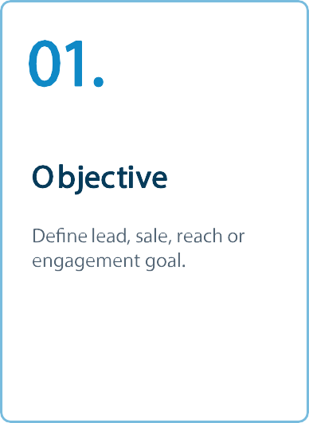
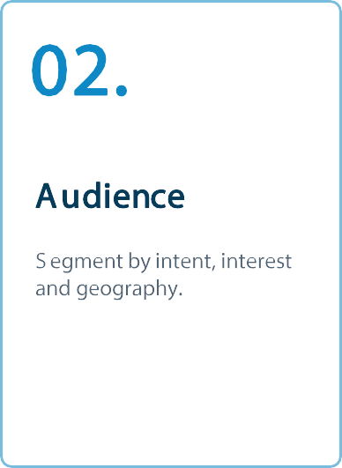
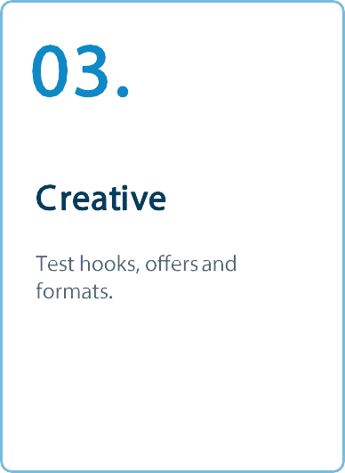
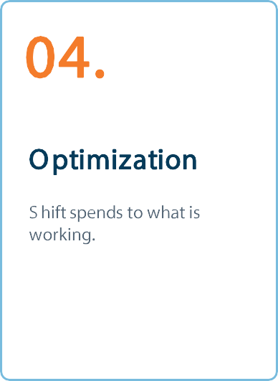
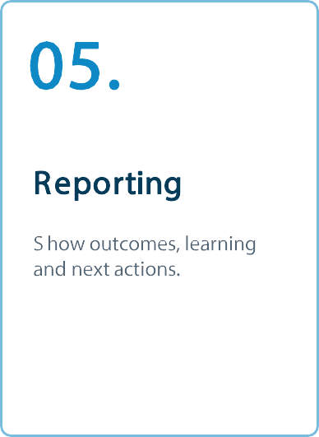

Slide 15










Slide 16



























Slide 17




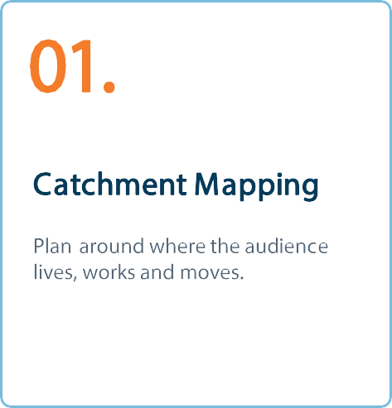
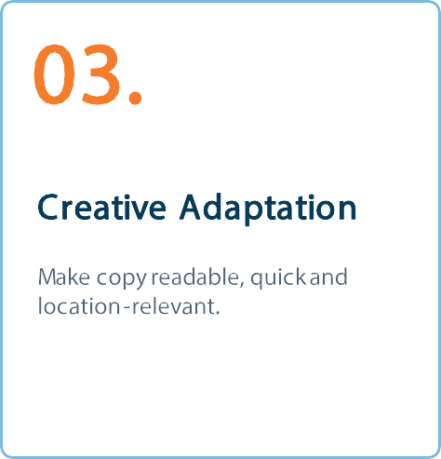
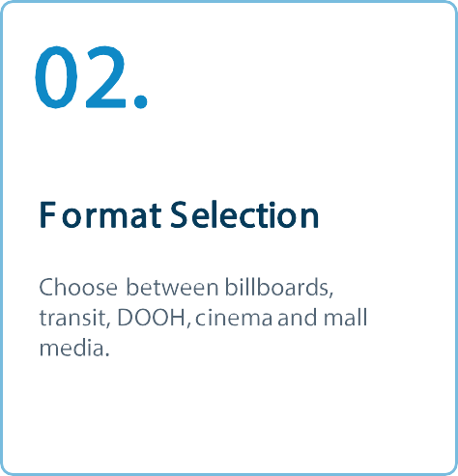
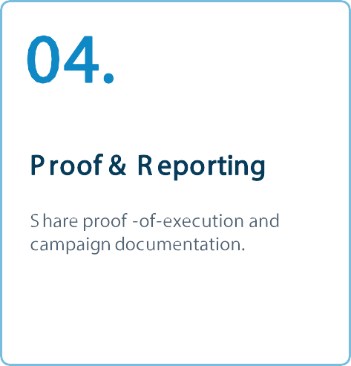

Slide 18
SERVICE SECTION
05.
Messaging Solutions
WhatsApp and RCS campaigns that use the inbox responsibly and
convert conversations.
MESSAGING SOLUTIONS
18

Slide 19





Slide 20





Industries We Serve
WHO WE WORK WITH
01. Retail & eCommerce
Media planning adapted to category, objective and customer journey.
02. Hospitality & Food
Media planning adapted to category, objective and customer journey.
03. Health & Wellness
Media planning adapted to category, objective and customer journey.
04. BFSI & Fintech
Media planning adapted to category, objective and customer journey.
05. Professional Services
Media planning adapted to category, objective and customer journey.
06. Education
Media planning adapted to category, objective and customer journey.
One planning lens, tailored for different consumer journeys.
20

Slide 21



Why Brands Trust Us With Their Media Budget.
WHY US
Client-First Partnership
Transparent Buying
We work as an extension of your team — not just another vendor sending reports.
Clear rate cards and clear reporting, so you know where money goes.
Agile Execution
Full-Funnel Expertise
Lean processes mean faster launches and quicker pivots when a
campaign needs one.
One team fluent across publishers, streaming, OOH and
messaging — not just one channel.
Media buying, done with strategy — not guesswork.
21

Slide 22
How We Move From Brief To Live Campaign.
WORKING PROCESS
01.
Brief Decode
Campaign objective, target audience and budget guardrails.
02.
Media Architecture
Channel mix, sequencing
and plan recommendation.
03.
Buying & Setup
Negotiation, booking, tracking and creative specifications.
04.
Launch & Optimize
Go live, monitor, optimize
and solve in real time.
05.
Report & Learn
Share proof, metrics, learnings and next- step recommendations.
22

Slide 23


























Trusted by Remarkable Brands.
OUR CLIENTS

Slide 24

Let’s Plan Your Next Campaign.
Ready to put your media budget to work? Let’s talk.
GET IN TOUCH
sales@bluewavesmedia.in
+919830048870
www.bluewavesmedia.in
BLUE WAVES MEDIA · COMPANY PROFILE 2026

